Slide 1

Investment Opportunity
IDR 14B
GATRA
for 15% equity
Indonesia's AI-Powered Cybersecurity Infrastructure
Market Growth
24% CAGR
Indonesia cybersecurity market
Guardian Agent for Threat Response & Autonomy
Detect Faster. Respond Smarter. Evolve Continuously.
Market Opportunity
64M+ SMEs
Underserved Indonesian businesses
First-Mover Advantage in Indonesia

Slide 2

Strategic Vision & Value Proposition
From AI-Driven SOC to National Cognitive Defense Layer
GATRA is building the foundational AI layer that protects, learns, and evolves with Indonesia's digital economy.
Value Proposition
Enterprise-grade AI cybersecurity at SME-friendly prices through proprietary multi-agent framework.
Market Impact
Serving 64M+ underserved Indonesian SMEs with affordable, autonomous protection.

Slide 3




The Problem: Traditional Cybersecurity Failures
Traditional SOC Solutions Leave Indonesian Businesses Vulnerable
Too Slow
Too Expensive
Too Reactive
194 days
IDR 1.5B+
30%+
Average time to identify and contain a breach
Annual cost for enterprise SOC solutions
False positive rate overwhelming security teams
Impact:
Impact:
Impact:
Attackers have months to steal
99% of Indonesian businesses
70% of organizations report
data, deploy ransomware, and
cannot afford enterprise
significant business disruption
cause damage
cybersecurity

Slide 4

The Solution: GATRA's Multi-Agent AI Platform
Autonomous AI Agents Deliver 65-Second Threat Response
ADA
TAA
CRA
CLA
RVA
Anomaly Detection Agent
Triage & Analysis Agent
Containment & Response Agent
Continuous Learning Agent
Risk & Validation Agent
Monitors network traffic and identifies anomalies in real-time
LLM-powered threat intelligence and classification
Autonomous response and remediation actions
Reinforcement learning from every incident
Validates responses and assesses risk levels
5s
24/7
ISO
15s
94%
42001
accuracy
Total Response Time
≈65 seconds
vs 194 days for traditional solutions
Platform
Local LLM
Governance
Google Cloud
Bahasa Indonesia
ISO 42001-Ready

Slide 5



Execution Roadmap: 5 Phases to Market Leadership
1-2
3
4
5
6
Prototype
Piloting
Rollout
Go-to-Market
Predictive Twin Fabric
Jun-Oct 2025
Oct 2025
Q4 2025
Q1 2026
UPCOMING
UPCOMING
2026+
COMPLETED
IN PROGRESS
UPCOMING
• Multi-agent platform built
• 3 pilot customers
• Production deployment
• Commercial launch
• GCP deployment ready
• Performance validation
• Infrastructure scaling
• Customer acquisition
• Predictive threat modeling
• Core AI capabilities
• Product-market fit
• Security certifications
• Market expansion
• Digital twin simulation
validated
• Platform extensibility
Immediate Next Steps
Complete pilot validation → Deploy to production environment → Launch commercial operations with initial customer base → Scale to target market segments
Notes:
Concept:
- Phases 1–5: adaptive SOC (detect→triage→respond→learn, ~65s cycle).
- Phase 6: predictive defense via digital-twin simulation + federated learning.
- Outcome: Pre-emptive controls and proactive containment suggestions.
Takeaway: Clear evolution to a sovereignty-aligned predictive security fabric.

Slide 6

GATRA's Evolution: Product to Platform to Infrastructure
From Product to Platform to National Defense Layer
STAGE 1
STAGE 2
STAGE 3
Product
Platform
Infrastructure
AI-powered SOC solution for enterprise customers
Extensible security platform for ecosystem partners
Indonesia's secure AI layer and national defense fabric
• Multi-agent AI platform
• Bahasa Indonesia LLM
• Default security for SMEs
• 65-second response time
• API-first architecture
• National threat intelligence
• Cloud-native deployment
• Partner integrations
• Regulatory compliance
• Enterprise-grade security
• White-label capabilities
• Digital sovereignty

Slide 7

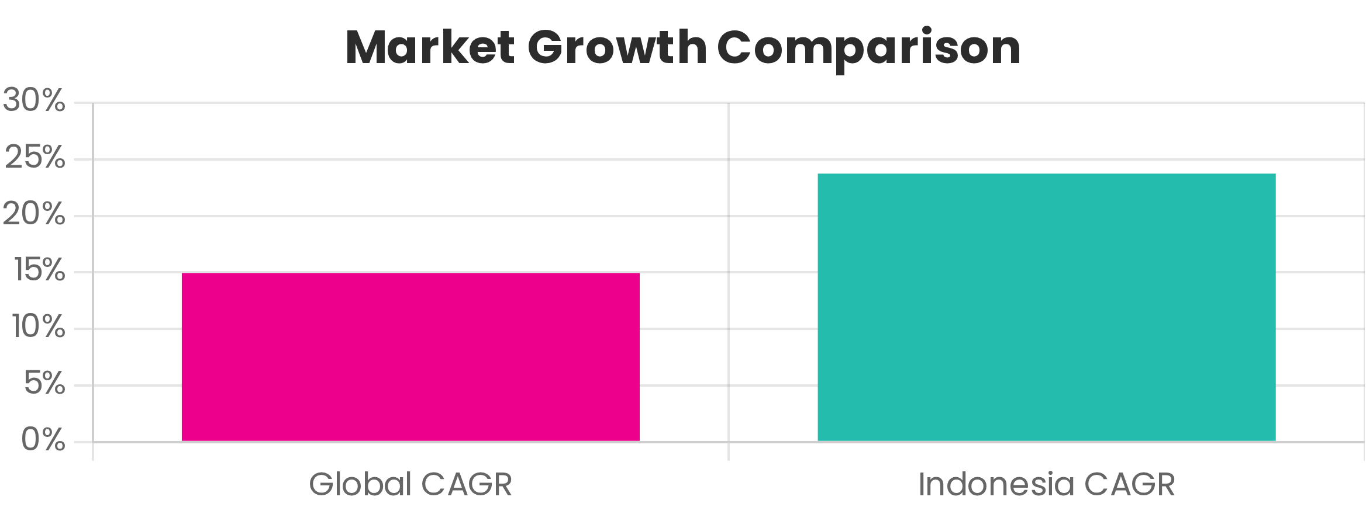
Market Opportunity: $272B Global Market, 24% CAGR Indonesia
Global Cybersecurity Market
Competitive Advantages
$272B
64M+ Target Market
15.1% annual growth globally
Underserved Indonesian SMEs need affordable cybersecurity
Indonesia Market Growth
24% CAGR
First-Mover Advantage
2–3-year head start in Indonesian AI cybersecurity market
60% faster than global average
Local LLM
Bahasa Indonesia language support for regulatory compliance
Strategic Ecosystem
Telco/Banking partnerships for rapid distribution
Notes:
Primary Source: IDC Asia / Frost & Sullivan (2024)
- Indonesia CAGR: ~23–25% vs Global ~15%.
- Drivers: PDP enforcement; fintech; cloud/AI adoption; compliance.
- Math: (24-15)/15 ≈ 60% faster than global.
Takeaway: Timing is favorable; regulatory pull supports growth.

Slide 8



The Market Gap: 64M Underserved SMEs
The Consequence of Broken Traditional Cybersecurity
64M Indonesian SMEs
are underserved and vulnerable to cyber threats
Primary Source: Indonesia Ministry of Cooperatives & SMEs (Kemenkop UKM, 2024)
70%
$4.88M
Business Disruption
Average Breach Cost
of organizations report significant operational disruption from cyber threats
Global average cost of a data breach, devastating for SMEs
According to IBM’s 2024 Data Breach Report,
Notes:
Primary Source: Indonesia Ministry of Cooperatives & SMEs (Kemenkop UKM, 2024)
- 64M+ SMEs contribute ~60% of GDP; accelerating digital adoption.
- Gap: Most SMEs cannot afford enterprise SOC.
- Penetration math: 0.1% of 64M = 64,000 customers; IDR 1–2M/month → material ARR.
Takeaway: Real, underserved segment; pricing + autonomy make it addressable.
According to IBM’s 2024 Data Breach Report, 70% of breached organizations
experienced major operational disruption — a risk magnified for SMEs lacking SOC coverage.
TAM: 64M SMEs x IDR 12M/year = IDR 768T total potential.
SAM: 10% SMEs likely to adopt AI SOC = IDR 76T.
SOM: Initial 0.1–0.5% penetration = IDR 0.7–3.8T reachable.

Slide 9

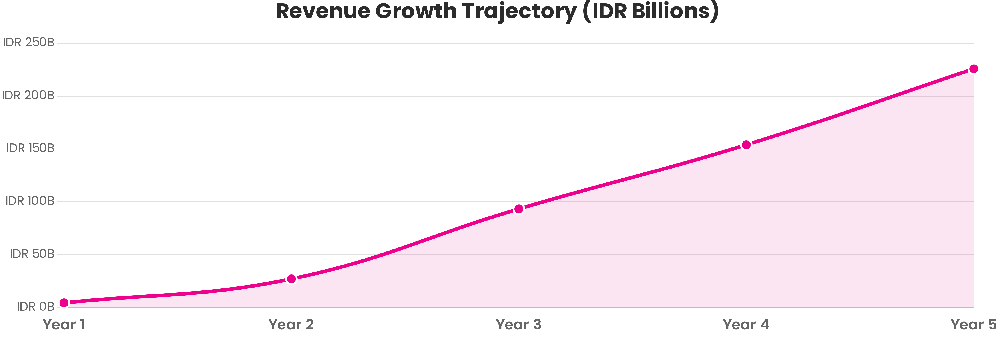
Revenue Growth Trajectory: IDR 4.5B to IDR 228B
50x Revenue Growth in 5 Years
Customer Base Scaling
Year 1
Year 5
Total Customer Growth
IDR 4.5B
IDR 228B
15 → 761
15 customers
761 customers
50x customer base expansion
Notes:
Projection Logic:
- ARPU: IDR 25M/year; Customer count: 15 → 761 (5 years) via MSSP/telco channels.
- Gross Margin ~75%; LTV/CAC improves with channel leverage.
Guardrails: Include conservative/base/aggressive cases; show ARPU & conversion sensitivity.
Takeaway: Ambitious but defensible with partner distribution.

Slide 10

Sales Pipeline & Commercial Strategy
ARR Target by December 2026
USD 150-200K
Tier 1: Active Pilots
Tier 2: MOUs Signed
Tier 3: Prospects
In-progress validation
Strategic partnerships
Active pipeline
• BNC (Bank Neo Commerce)
• KomDigi (Ministry of Digital Affairs)
• SeaBank
• BTN (Bank Tabungan Negara)
• Kredivo
• Jago (Bank Jago)
• BSSN (National Cyber Agency)
• Akulaku
• Blu (BCA Digital)
• Mandiri (Bank Mandiri)
• Regional Fintechs
• Telkom Indonesia

Slide 11

Investment Terms & Financial Returns
Investment Amount
5-Year ROI
IDR 14B
225%
for 15% equity stake
Validated financial projection
Terminal Value
Payback Period
IDR 1.8T
12-15 months
at 4x revenue multiple
Rapid capital efficiency

Slide 12

Leadership Team: CEO & CTO
Enterprise-Grade Experience Building AI Security Solutions
30+ Years
Combined Expertise in AI & Cybersecurity
Raditio Ghifiardi
CEO & Co-Founder
20+ years
in AI and Cybersecurity. Former enterprise architect at Fortune 500 companies. Deep
expertise in AI-driven security solutions and digital transformation.
Rendy Darmawidjaja
CTO & Co-Founder
12+ years
as AI/ML Architect. Specialized in building scalable multi-agent systems and cloud-native
platforms. Track record of deploying production AI at scale.

Slide 13




Terminal Value & Exit Pathways
Multiple Strategic Exit Options with Strong Valuation
Projected Terminal Value
IDR 1.8T
at 4x revenue multiple (Year 5)
Strategic Exit Pathways
IDX IPO
Public listing on Indonesia Stock Exchange, capitalizing on local market enthusiasm for tech IPOs
Telco/Cloud M&A
Strategic acquisition by telecommunications or cloud infrastructure providers seeking cybersecurity capabilities
PE Secondary Sale
Private equity buyout for continued growth and regional expansion

Slide 14




Competitive Advantage: Three Sustainable Moats
Building Defensible Competitive Position in Indonesian Market
First-Mover Advantage
Technology Leadership
Local Market Expertise
2-3 years
Proprietary
64M SMEs
Head start in Indonesian AI cybersecurity market
Multi-agent architecture with local LLM
Deep understanding of Indonesian business landscape
Early market entry creates brand recognition, customer relationships, and regulatory partnerships that competitors cannot easily replicate
Unique AI framework combining autonomous agents with Bahasa Indonesia language model creates technical barriers to entry
Regulatory compliance, local language support, and ecosystem partnerships position GATRA as the trusted local solution

Slide 15




Thank You
GATRA
Next Steps
Schedule a due diligence meeting to discuss partnership opportunities and explore how we can work together to secure Indonesia's digital future.
Email:
raditio.ghifiardi@gmail.com
Website:
www.gatra.id
Let's Transform Indonesia's Digital Security Landscape Together
Protecting 64M SMEs with AI-Powered Cybersecurity Infrastructure

Slide 16




Defensible Market Position
How Three Moats Combine to Protect Market Leadership
Combined Defensibility
Technology innovation + Market timing + Local expertise = Sustainable competitive moat protecting market leadership position
Technology Innovation
Market Timing
Local Expertise
Proprietary multi-agent AI architecture creates technical barriers to entry
2-3 year first-mover advantage establishes brand and partnerships
Deep Indonesian market knowledge and regulatory compliance
Strategic Outcome
Defensible competitive position that protects GATRA's market leadership in Indonesia's cybersecurity landscape

Slide 17




Ultimate Vision: Securing Indonesia's Digital Economy
Ultimate Vision
Become Indonesia's secure AI layer and default security fabric for 64M SMEs, protecting the
nation's digital economy with autonomous, intelligent, and continuously evolving
cybersecurity infrastructure.
Autonomous & Intelligent
Digital Sovereignty
Continuously evolving AI-powered defense that learns and adapts to emerging threats without human intervention
Indonesian-built solution ensuring data sovereignty, regulatory compliance, and national cybersecurity independence

Slide 18

Financial ROI: Investor Value
Investor Returns
5-Year ROI
Terminal Value
225%
IDR 1.8T
for investors
at 4x revenue multiple
Revenue Growth
Gross Margin
50x
75%
in 5 years
best-in-class SaaS economics
Win-Win Value Creation: Customers get enterprise-grade protection at 10% of the cost,
while investors capture a massive underserved market with exceptional unit economics.

Slide 19

Global Comparables & Valuation Benchmarks
AI Cybersecurity Success Stories Validating GATRA's Valuation
Global AI Cybersecurity Exits
Darktrace
$2B
London Stock Exchange IPO (2021)
Cybereason
$1.5B
Strategic acquisition valuation
SentinelOne
$9B
NYSE IPO (2021)
Valuation Validation
These global comparables demonstrate strong market appetite for AI-powered cybersecurity solutions and validate
GATRA's IDR 1.8T terminal value projection as conservative and achievable.

Slide 20



Market Validation & Strategic Partnerships
Concrete Evidence of Market Acceptance and Strategic Traction
Market Validation
20+
Customer Interviews
Deep market research validating product-market fit
MSSP Partnership
Strategic managed security service provider collaboration
Telco Ecosystem
Integration with telecommunications infrastructure partners

Slide 21



Active Pilots & ARR Potential
Proven Market Traction with Active Customer Engagements
Combined ARR Potential
IDR 100M-200M
Active Pilots
Telco
Major Telecommunication Company
FINTECH
Digital Banking Platform
E-COMMERCE
Online Marketplace

Slide 22

How It Works: 65-Second Response Cycle
From Detection to Containment in 65 Seconds vs 194 Days
1
2
3
4
DETECT
ANALYZE
RESPOND
CONTAIN
15 seconds
30 seconds
5 seconds
15 seconds
AI monitors network traffic and identifies anomalies in real-time
LLM provides human-like threat intelligence with 94% accuracy
Autonomous containment actions without human intervention
Complete threat isolation and system protection
99.24%
79%
24/7
False Positive Reduction
Workload Reduction
Autonomous Coverage

Slide 23

Investment Terms & Expected Returns
Join Indonesia's AI Cybersecurity Revolution
Investment Amount
IDR 14B
for 15% equity stake
Expected 5-Year ROI
295%
Validated financial projection
Terminal Value
IDR 1.8T
at 4x revenue multiple

Slide 24


Use of Funds & Call to Action
Strategic Allocation for Maximum Impact
Use of Funds
Technology Development
40%
Team Expansion
40%
Marketing & Sales
15%
Working Capital
5%
Ready to Transform Indonesia's Digital Security?
Partner with us to build the foundational AI layer protecting 64M Indonesian SMEs

Slide 25





Team Composition & Core Strengths
17
Highly Skilled Professionals
AI & Machine Learning
Cybersecurity
Multi-agent systems, LLM integration, reinforcement learning
SOC operations, threat intelligence, incident response
Cloud Infrastructure
Enterprise Sales
GCP deployment, scalable architecture, DevOps
Banking, fintech, telco partnerships
The Perfect Balance: Deep enterprise expertise to build world-class solutions + startup speed to
capture market opportunity

Slide 26

GATRA Investment Scenario - Part 1
5-Year Financial Projections
Metrics
Year 1
Year 2
Year 3
Year 4
Year 5
REVENUE METRICS
Revenue (IDR Billions)
4.50
27.39
94.38
155.73
228.40
Growth Rate (%)
-
508%
245%
65%
47%
Total Customers
15
91
314
519
761
ARPU (IDR Millions/month)
25
25
25
25
25
COST STRUCTURE
COGS (IDR Billions)
1.13
6.85
23.59
38.93
57.10
Operating Expenses (IDR Billions)
5.95
7.14
8.57
10.28
12.34
Total Costs (IDR Billions)
7.08
13.99
32.16
49.21
69.44
PROFITABILITY
Gross Profit (IDR Billions)
3.37
20.54
70.79
116.80
171.30
Gross Margin (%)
75%
75%
75%
75%
75%
Net Profit (IDR Billions)
-2.58
13.40
62.22
106.52
158.96
Net Margin (%)
-57%
49%
66%
68%
70%
Note: All figures are in Indonesian Rupiah (IDR). Projections based on conservative market penetration assumptions and validated pricing models.

Slide 27

GATRA Investment Scenario - Part 2
5-Year Financial Projections (Continued)
Metrics
Year 1
Year 2
Year 3
Year 4
Year 5
USE OF FUNDS (IDR 14B)
Technology Development (40%)
5.60B
AI/ML infrastructure, cloud services, security tools
Premium Team (40%)
5.60B
17 highly skilled professionals
Marketing & Sales (15%)
2.10B
Market penetration and customer acquisition
Working Capital (5%)
0.70B
Operations and contingency
KEY METRICS
CAC (IDR Millions)
140
23
7
5
4
LTV (IDR Millions)
900
900
900
900
900
LTV/CAC Ratio
6.4x
39.1x
128.6x
180.0x
225.0x
Payback Period (Months)
6
1
0.3
0.2
0.2
Investment Highlights:
The LTV/CAC ratio improves dramatically from 6.4x in Year 1 to 225x by Year 5, demonstrating exceptional unit economics and scalability. The 6-month payback period in Year 1 indicates rapid capital efficiency.
Note: All figures are in Indonesian Rupiah (IDR). Projections based on conservative market penetration assumptions and validated pricing models.

Slide 28

Key Financial Metrics & Unit Economics
Gross Margin
5-Year ROI
75%
225%
Best-in-class SaaS efficiency
Validated financial projection
LTV/CAC Ratio
Payback Period
6.4x → 225x
6 → 0.2 months
Year 1 to Year 5 improvement
Rapid capital efficiency

Slide 29

Operational ROI: Customer Value
Exceptional Returns for GATRA Customers
Customer Value Proposition
Year 1 ROI
Payback Period
450%
2.2 months
for customers
rapid value realization
Annual Savings
Cost Reduction
$1.1M+
90%
per customer
vs traditional enterprise SOC

Slide 30
Market Sizing: TAM, SAM, and SOM
TAM (Total Addressable Market):
64M+ SMEs in Indonesia (Kemenkop UKM, 2024).
Avg. spend potential: IDR 12M/year.
TAM ≈ IDR 768T (~USD 48B).
SAM (Serviceable Available Market):
Digitally active SMEs ≈ 10% (~6.4M SMEs).
SAM ≈ IDR 76.8T (~USD 4.8B).
SOM (Serviceable Obtainable Market):
0.1% capture (~6,400 clients).
SOM ≈ IDR 76.8B (~USD 4.8M) annual revenue.
→ Conclusion: Even a 0.1% share supports meaningful recurring ARR for scale.

Slide 31
Revenue Growth Sensitivity Scenarios (5-Year Outlook)
Conservative Case:
0.05% SME penetration (~3,200 clients).
ARPU IDR 20M/year → Revenue ≈ IDR 64B in Year 5.
Base Case:
0.1% SME penetration (~6,400 clients).
ARPU IDR 25M/year → Revenue ≈ IDR 160B in Year 5.
Aggressive Case:
0.2% SME penetration (~12,800 clients).
ARPU IDR 30M/year → Revenue ≈ IDR 384B in Year 5.
→ All models maintain 70–75% gross margin through AI-driven SOC scalability.

Slide 32
AI-Driven SOC: Multi-Agent Interactive Overview
Action Layer
SOC Dashboard
Automated Response
Compliance Reporting
•
•
Intelligence Layer
ADA Agent
•
TAA Agent
•
CRA Agent
Processing Layer
BigQuery Analytics
•
Vertex AI
•
ML Models
Telemetry Layer
Chronicle SIEM
•
Firewalls
•
Security APIs
Interactive flow: ADA → TAA → CRA → Dashboard | CLA (Learning) | RVA (Reporting)

Slide 33
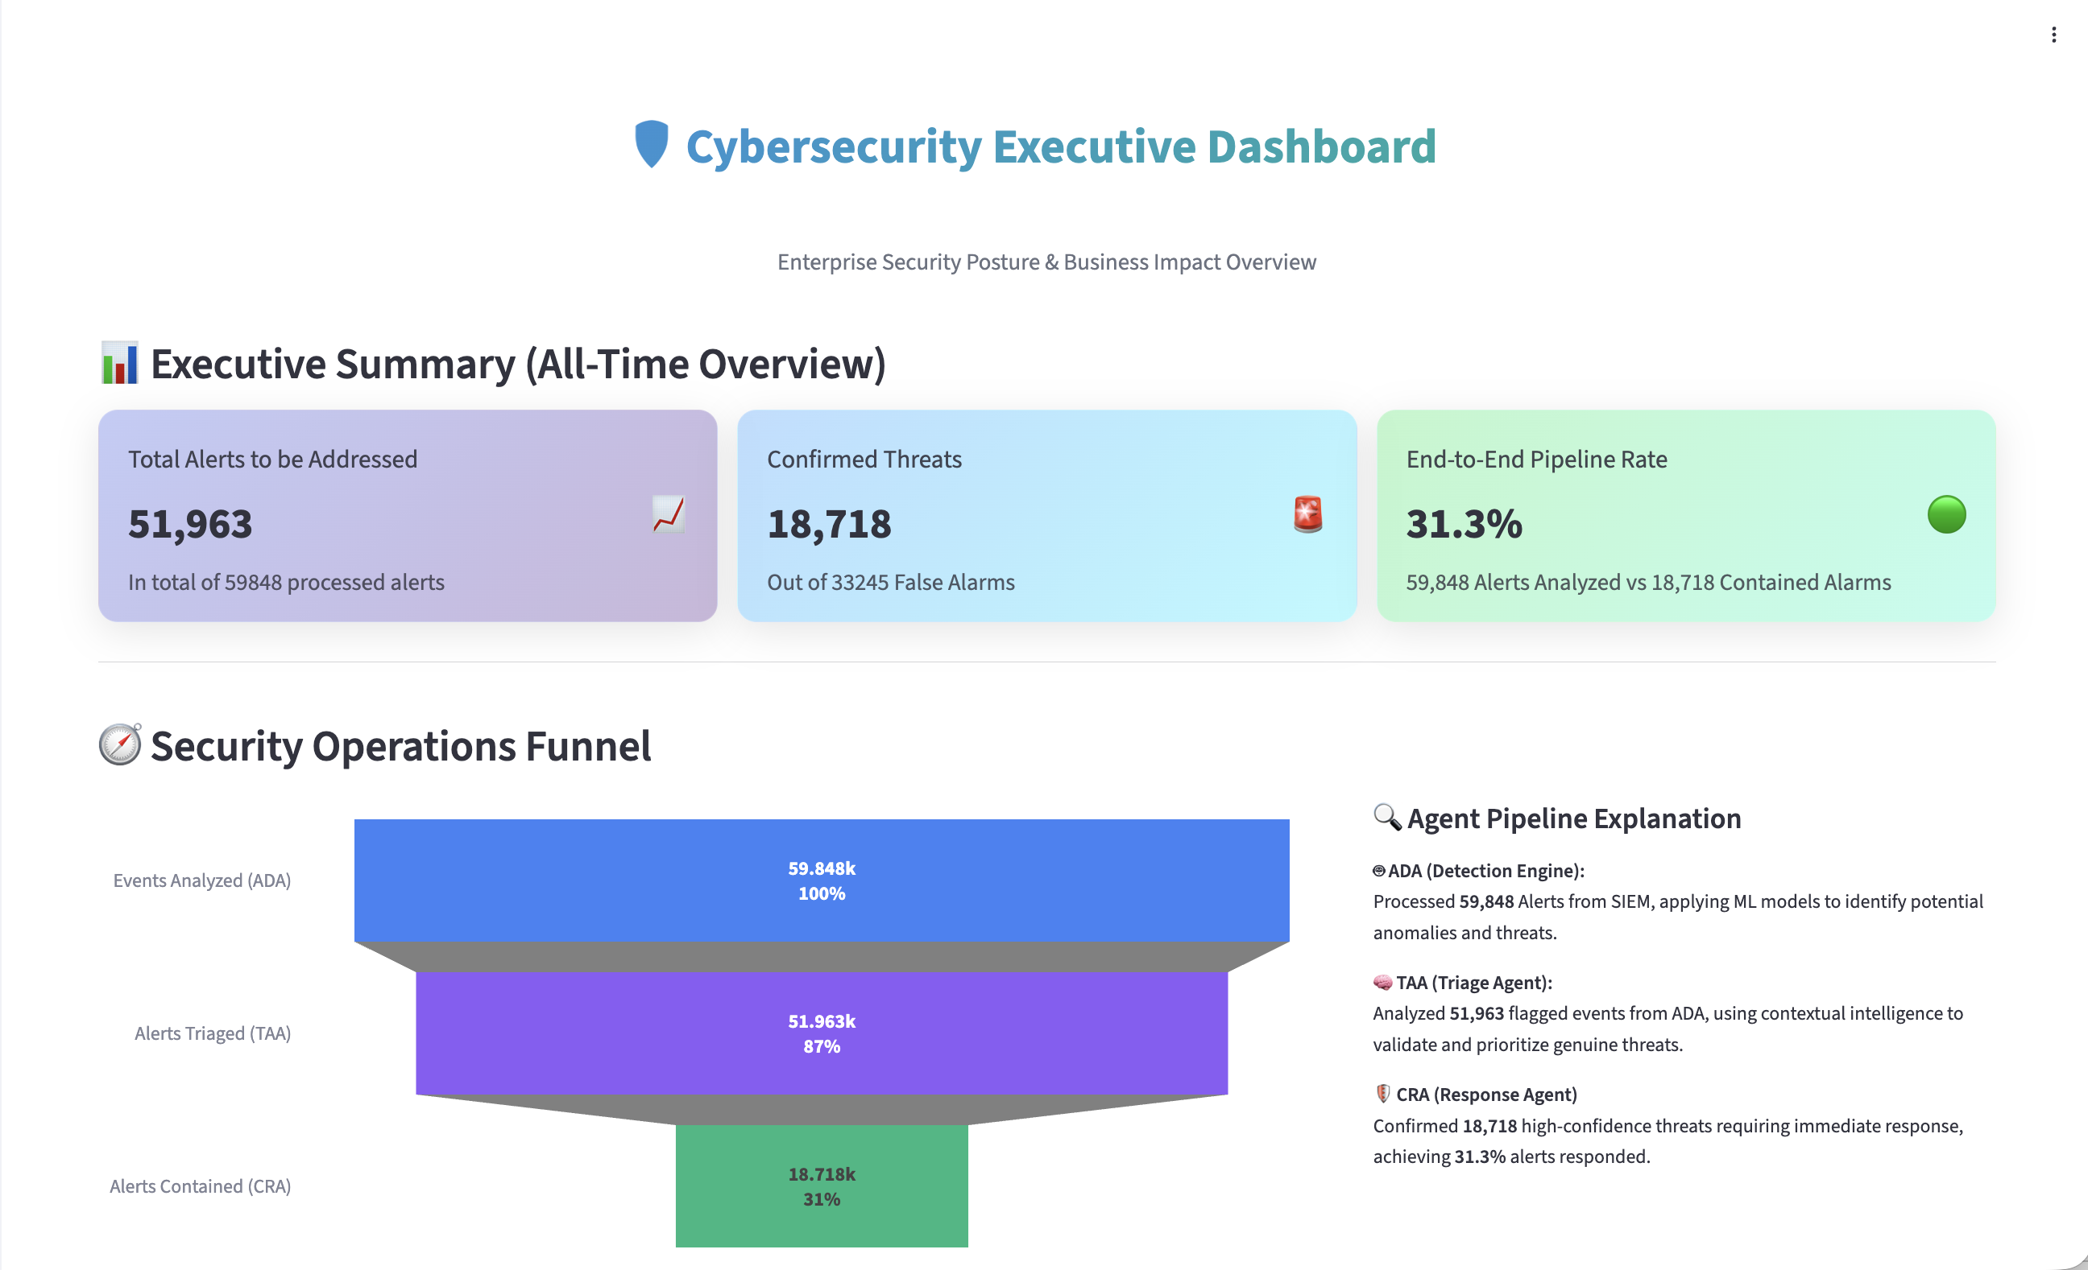
Solution Development - Executive Dashboard Snapshot
Real-time visibility into enterprise-scale security operations with intelligent data stratification:
1,719,668
131,053
Raw Events Processed
Events for Analysis
Enterprise-scale coverage
Intelligent prioritization
18,718
99.24%
Confirmed Threats
False Positive Reduction
Actionable incidents
0.76% confirmation rate
🚀 Detection Phase
💗 Triage Phase
15.2 Sec(s)
8.8 Sec(s)
Average Detection Time
Average Triage Time
From 6 Hours to 50 Seconds
This 99.8% reduction in response time means threats are contained and mitigated before they can cause significant damage, fundamentally changing the security posture from reactive to proactive.
🎯 Response Phase
📊 Total MTTR
26.9 Sec(s)
50.9 Sec(s)
Average Response Time (Real CRA Data)
Mean Time to Response
GATRA Analytics Platform | Confidential

Slide 34
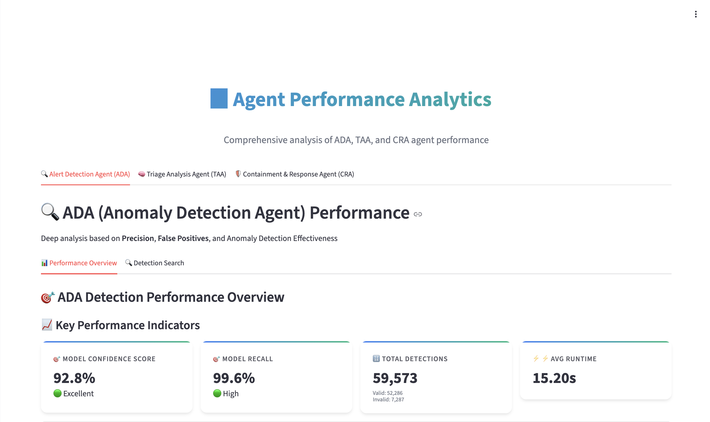
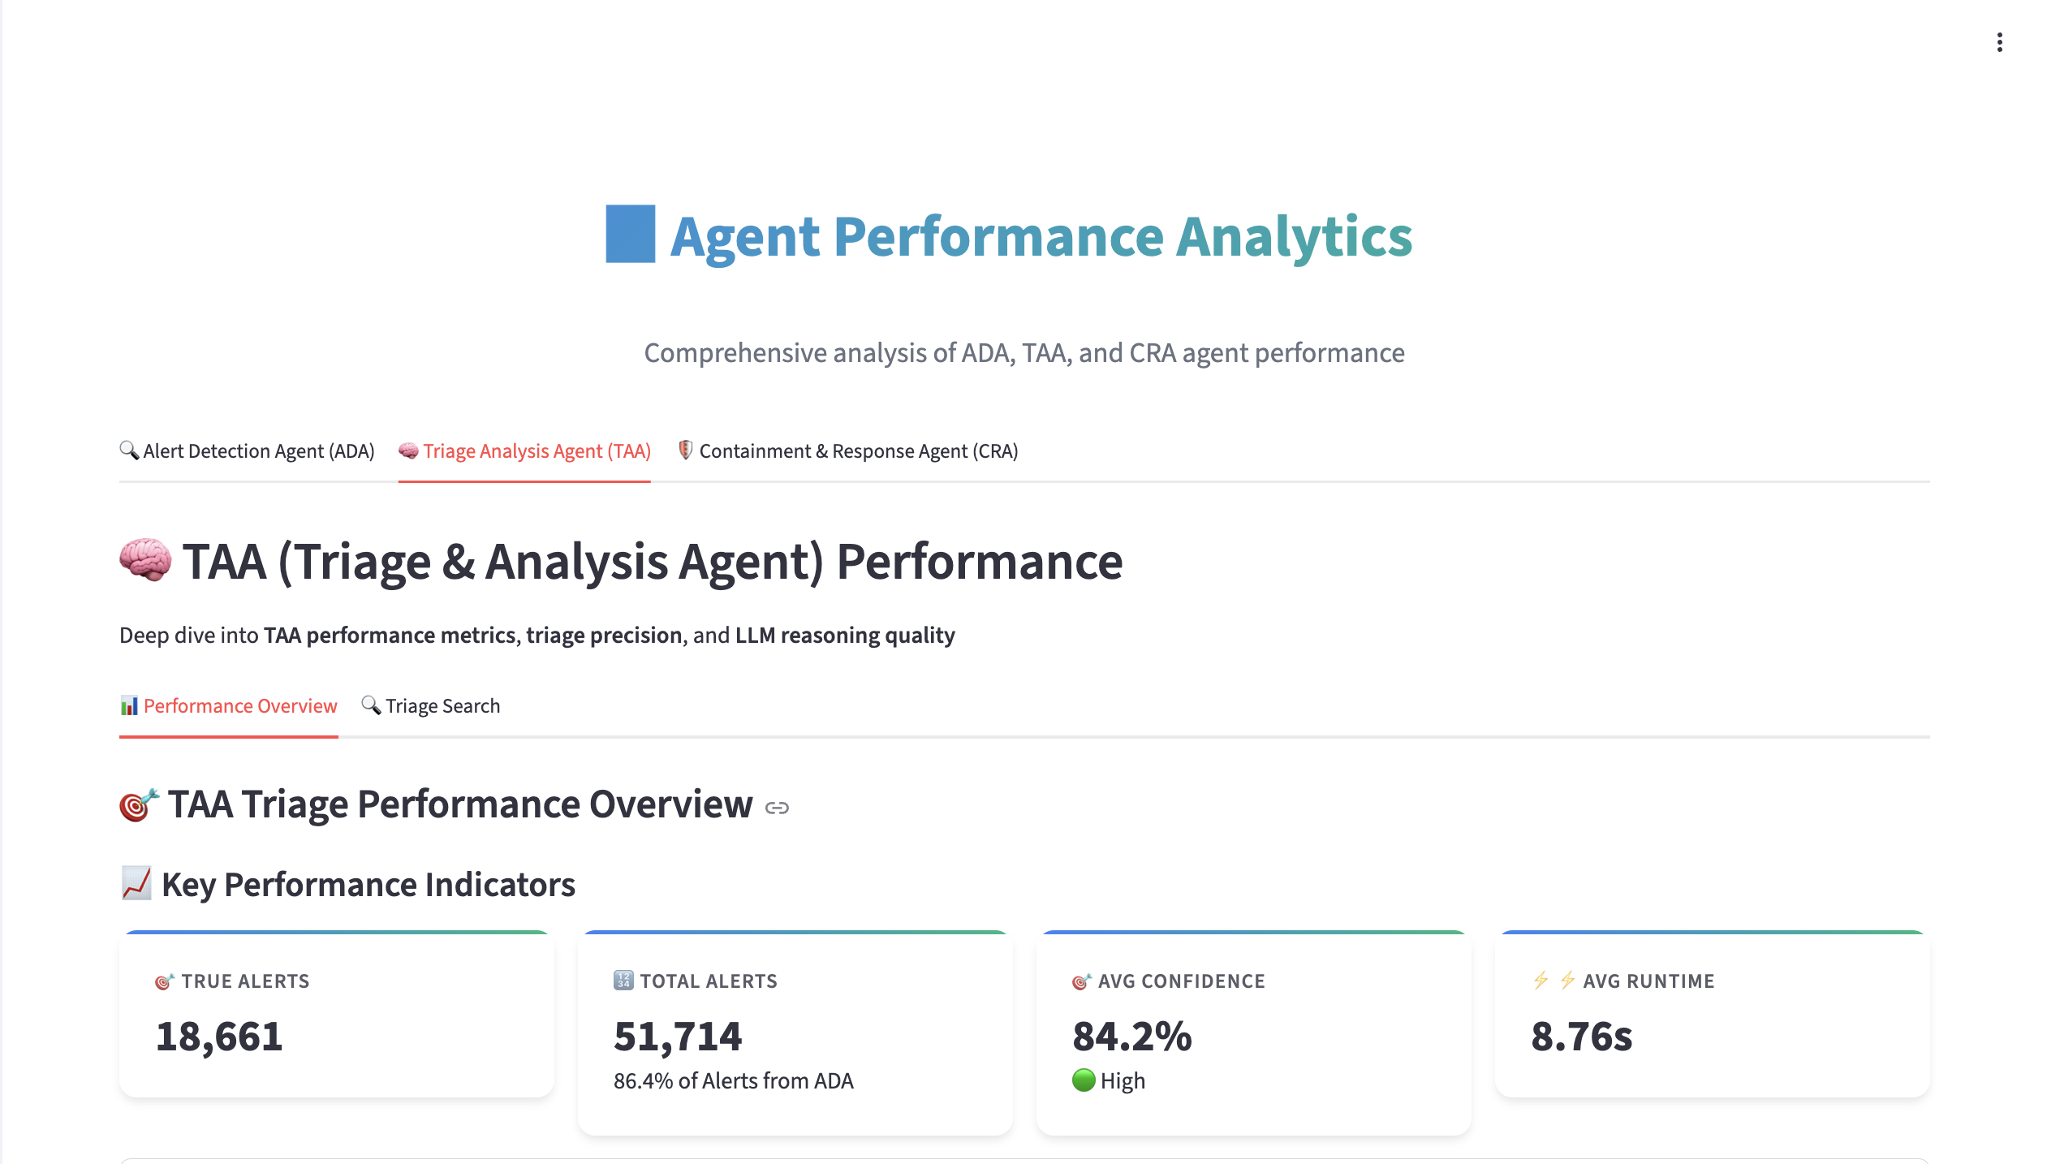
Solution Development - Agent Performance Analytics
From Detection to Cognition: The SOC That Learns from Itself
ADA (Anomaly Detection Agent)
TAA (Triage & Analysis Agent)
•
Confidence:
92.8%
(Excellent)
•
Precision:
65%
(Medium)
•
Recall:
99.6%
(Excellent)
•
False Positive Rate:
<30%
(Stable)
•
Detections:
59,848
•
Alerts:
51,714
•
Avg Runtime:
15.2s
•
Confidence:
84.2%
(High)
•
Avg Runtime:
8.76s
GATRA Analytics Platform | Confidential

Slide 35
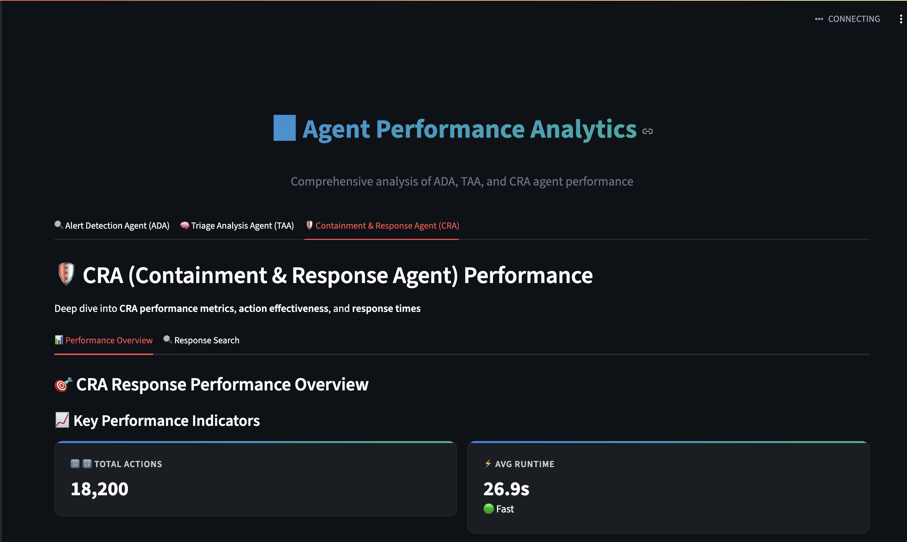
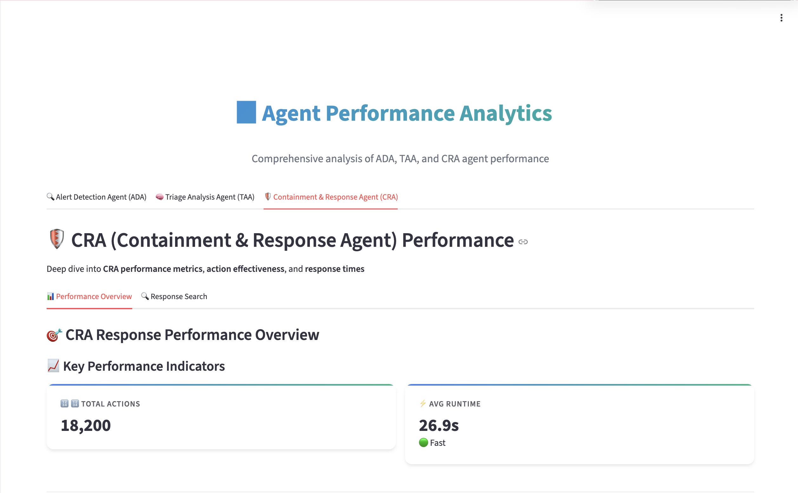
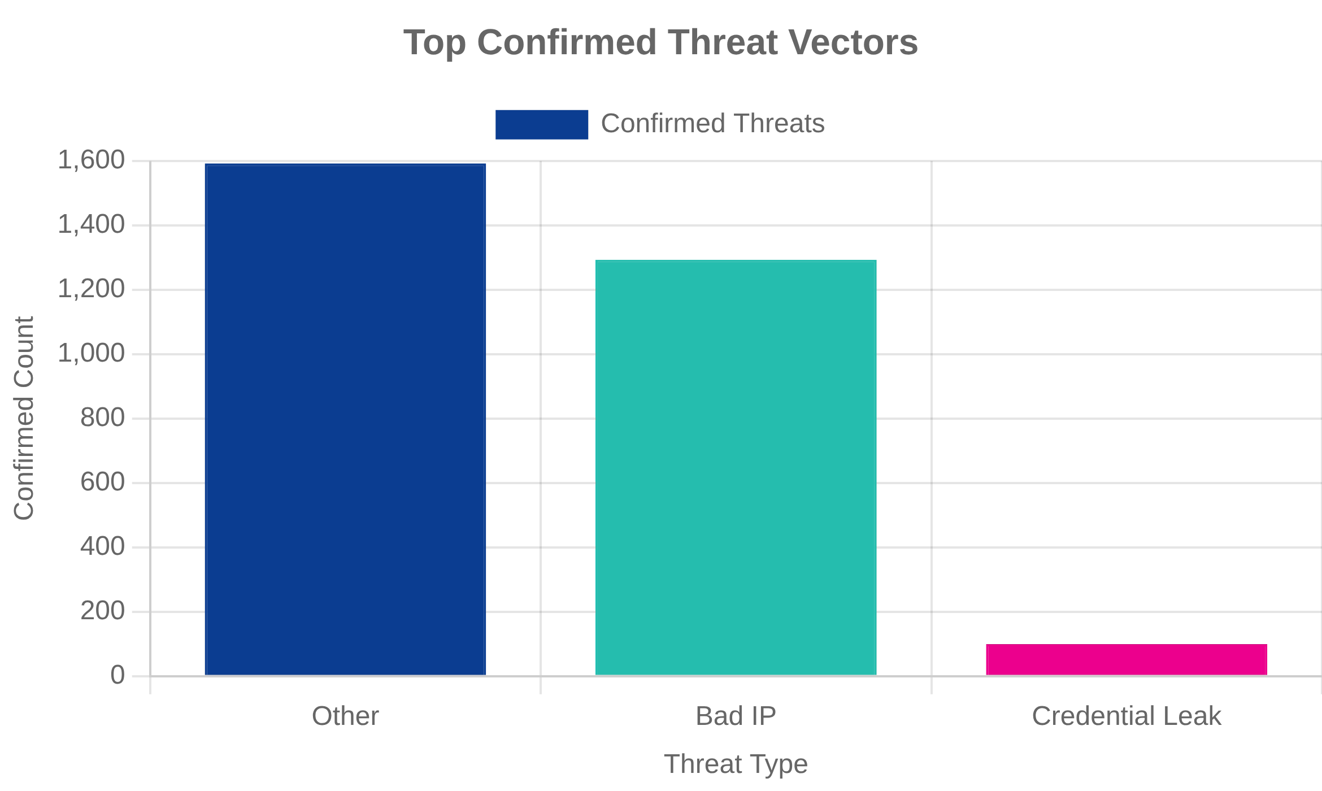
Solution Development - Agent Performance Analytics
The industry-leading performance!
CRA (Containment & Response Agent)
Threat Landscape (All-Time)
•
Success Rate:
96.3%
(Excellent)
•
Failure Rate:
2.5%
(Excellent)
•
Total Actions:
18,100
(Primary Function:
Email Notification)
•
Avg Runtime:
26.9s
(Acceptable)
GATRA Analytics Platform | Confidential

Slide 36
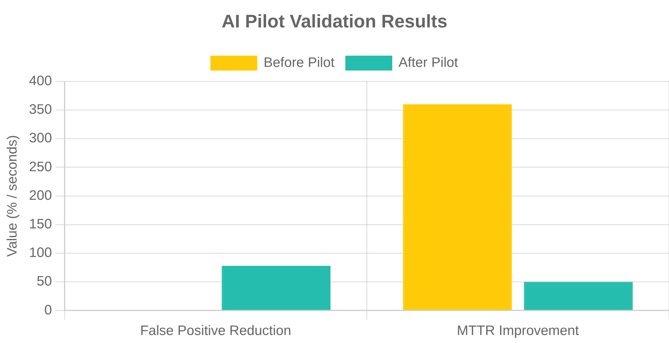


Solution Development - Key Features
Multi-agent SOC framework (ADA, TAA, CRA,
RVA, CLA)
Key Features Built So Far:
Automated anomaly detection
Intelligent triage & prioritization
Automated containment & response
Real-time reporting & dashboards
AI-Specific Progress:
Pilot validated: false positives reduced to
78%
MTTR improved to
50 seconds
GATRA Analytics Platform | Confidential

